Slide 1
Development session:
INTRODUCTION TO WEB3JS 7 pm – 8.30 pm 4 Jan
Cuong Truong Cong

Slide 2
Agenda
Ethereum DApp Architecture
Web3JS Overview
Web3JS Usage
Development pillar

Slide 3
Ethereum DApp Architecture

Slide 4
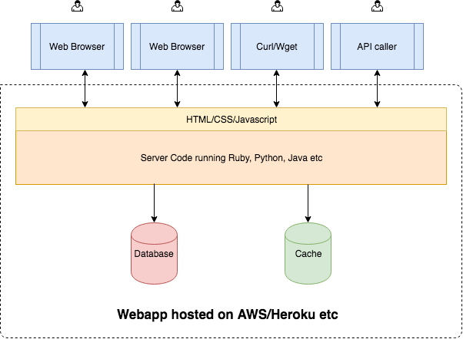
STANDARD WEB
User interaction here
Centralized WebApp
Notes:
Server side code: written in languages like Java, C#, Ruby, Python, etc.
Front-end code is implemented using HTML/CSS/Javascript
Application is hosting on a hosting provider like AWS, Microsoft Azure, Google Cloud Platform, Heroku or a VPS
Interaction is via web browser, curl/wget or through an API.
There is one web application which is centralized and all the clients interact with this one application.
When a client makes a request to the server, the server processes the request, interacts with the database and/or cache, reads/writes/updates the database and returns a response to the client.
Reference: https://www.zastrin.com/courses/ethereum-primer/lessons/1-4

Slide 5
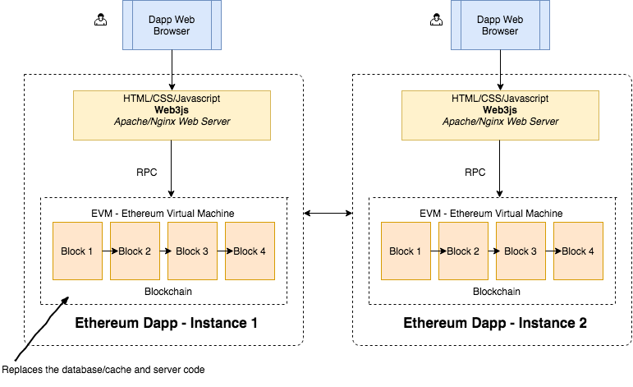
ETHEREUM ARCHITECTURE
What we will discuss today
Source: https://www.zastrin.com/courses/ethereum-primer/lessons/1-5
Notes:
In ideal decentralized world, every person who wants to interact with a dapp (Decentralized Application) will need a full copy of the blockchain running on their computer/ phone etc.
However, community come up with solutions (hosted blockchain servers, metamask)

Slide 6
Web3 Overview

Slide 7
WHAT IS WEB3? Poke poke
web3
a collection of libraries that allows a user to interact with the Ethereum platform and smart contracts

Slide 8
DIFFERENT IMPLEMENTATIONS Web3 Dot…
Python Web3.py
Haskell hs-web3
Java web3j
Easy to make, most used languages now have some kind of implementation in progress, but we will mainly focus on:
JavaScript web3.js

Slide 9
WHAT CAN WEB3.JS DO? Everything
It is the official Dapp API that is run on all the Ethereum nodes
Main Capabilities:
Interact with contract functions
Interfaces with Ethereum nodes from the network using JSON-RPC calls
Send data to contracts and initiate transactions
Query the blockchain for data (includes logged events by any contract along with block data)
Can have our back-end on chain, and our interface off chain

Slide 10
WHAT IS RPC? Poke poke
RPC
Remote Procedure Call (RPC) is a protocol that one program can use to request a service from a program located in another computer in a network without having to understand network details

Slide 11
JSON-RPC API Context behind Ethereum’s API
JSON is a lightweight data-interchange format
RPC is used to make remote function calls
JSON-RPC is a stateless, lightweight remote procedure call (RPC) protocol
Defines several data structures and the rules around their processing.
It is transport agnostic in that the concepts can be used within the same process, over sockets, over HTTP, or in many various message passing environments

Slide 12
ETHEREUM ABI Exposing contract methods
ABI = Application Binary Interface
An ABI is how you call functions in a contract and get data back
It determines how functions are called and in which binary format information should be passed from one program component to the next
Why is it necessary?
You need a way to specify which function in the contract to invoke as well as guarantee to what type of data is returned
Not part of the core Ethereum protocol, you can define your own ABI – but easier to comply with format provided by web3.js

Slide 13
ETHEREUM ABI Another analogy
API = Application Programming Interface
ABI = Application Binary Interface
So therefore an ABI is an API at a lower level?
Contract code is stored as bytecode in binary form on the blockchain under a specific address
You can access the binary data in the contract through the ABI
The ABI defines the structures and methods you will use to interact with binary contract (just like an API)

Slide 14
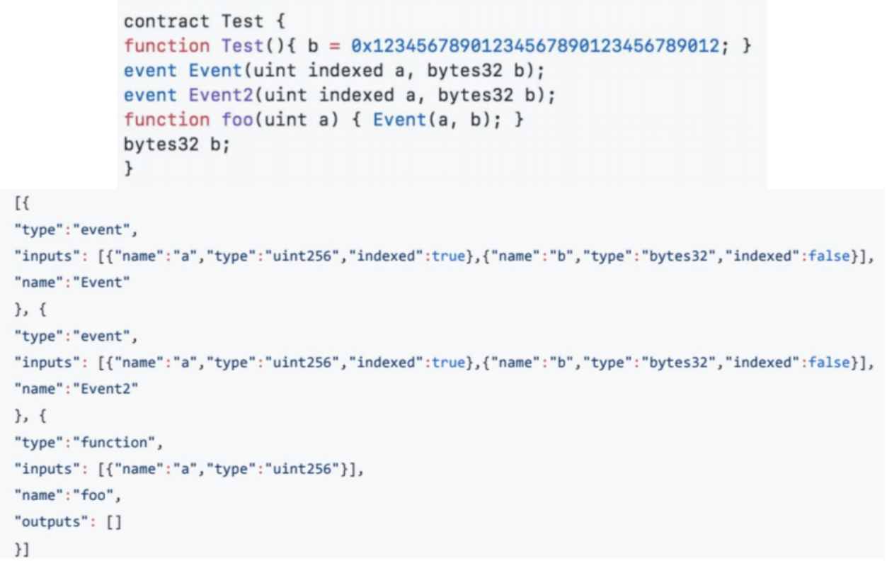
ETHEREUM ABI The lovely ABI format

Slide 15
Web3.js Usage

Slide 16
INSTALLING DEPENDENCIES
Node Package Manager: node –v
Web3.js Library: npm install web3
npm install dotenv

Slide 17
CONNECTING TO BLOCKCHAIN NODE
Web3.JS is our key to reading and writing the Ethereum Blockchain
Uses JSON RPC to talk to chain (Remote Procedure Call)
Need to connect to an Ethereum node – can use:
Can run your own Ethereum node with Geth or Parity. However, this requires you to download a lot of data from blockchain and keep it in sync
Infura provides a remote Ethereum node for free and is more convenient

Slide 18
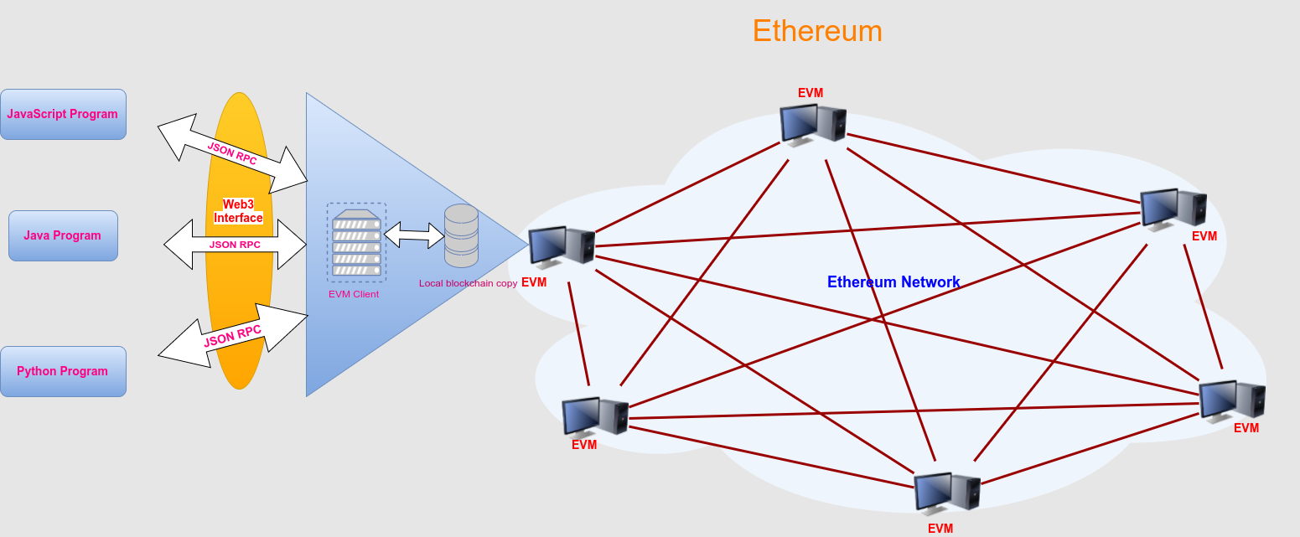
CONNECT TO BLOCKCHAIN NODE
Infura here

Slide 19
CHECKING ACCOUNT BALANCE Demo

Slide 20
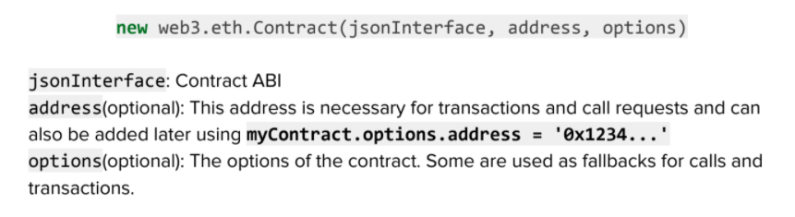
READ DATA FROM SMART CONTRACT
1. A JavaScript representation of the smart contract we want to interact with
2. A way to call the functions on the smart contract when reading the data
contract.methods.myFunction([arguments]).call()

Slide 21
READ DATA FROM SMART CONTRACT Demo

Slide 22

INSIDE ETHEREUM TRANSACTIONS
Whenever we create a transaction, we are writing data to the blockchain and updating its state
There are several ways to do this
Send Ether from one account to another
Call a smart contract function that writes data
Deploy a smart contract to the blockchain
In order to broadcast transactions to the network, we’ll need to sign them locally first.
Notes:
If we were running our own Ethereum node locally, we could unlock an account that was stored locally and sign all of our transactions locally. If that were the case, we would not necessarily need to use this library. However, we're using a remote node hosted by Infura in this tutorial. While Infura is a trustworthy service, we still want to sign the transactions locally rather than giving the remote node manage our private keys.

Slide 23
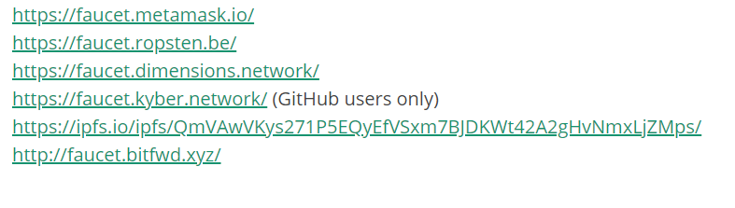
INSIDE ETHEREUM TRANSACTIONS Let’s get some fake Ether!
Use the Ropsten test network
Obtain the fake Ether from the following faucet:
If all the link for Ropsten does not work, you can use this link for kovan network: https://faucet.kovan.network/ and switch to Kovan network later in the codes

Slide 24
INSIDE ETHEREUM TRANSACTIONS
Four steps to get your transaction done
Build a transaction object
Sign the transaction
Broadcast the transaction to the network
Wait for magic to happen on the chain ☺

Slide 25
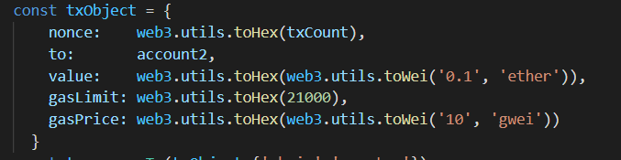
INSIDE ETHEREUM TRANSACTIONS Build your transaction object
Previous transaction count for the given account
The amount of Ether we want to send, must be expressed in Wei and converted to hexadecimal
The account we’re sending Ether to
The amount we want to pay for each unit of gas. 10 Gwei is used here
The maximum amount of gas consumed by the transaction. A basic transaction like this always cost 21000 units of gas
Notes:
nonce - this is the previous transaction count for the given account. We'll assign the value of this variable momentarily. We also must convert this value to hexidecimal. We can do this with the Web3.js utilitly web3.utils.toHex()
to - the account we're sending Ether to.
value - the amount of Ether we want to send. This value must be expressed in Wei and converted to hexidecimal. We can convert the value to we with the Web3.js utility web3.utils.toWei().
gasLimit - this is the maximum amount of gas consumed by the transaction. A basic transaction like this always costs 21000 units of gas, so we'll use that for the value here.
gasPrice - this is the amount we want to pay for each unit of gas. I'll use 10 Gwei here.
Anyone notices if there is anything missing here? (from address)

Slide 26
INSIDE ETHEREUM TRANSACTIONS Demo

Slide 27
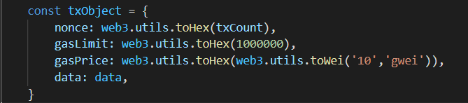
DEPLOYING SMART CONTRACTS Transaction object and demo
Bytecode of the smart contract that we want to deploy
Notes:
Again the three steps

Slide 28
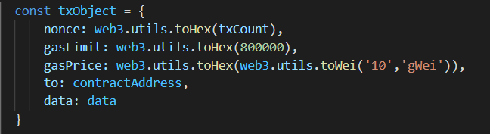
CALLING SMART CONTRACT FUNCTION Transaction object and demo
The address of the deployed contract
Hexadecimal representation of the function we want to call on the smart contract

Slide 29
Source code and references
Github repo:
https://github.com/cuongquangnam/web3_tutorial_BNS
References:
Blockchain at Berkeley slides:
https://drive.google.com/file/d/1v-hEK5Py7xgoj5s979zx1jS9IQ86jSc_/view
Introduction to Web3.js – DApp university (my demo is based on this)
https://www.dappuniversity.com/articles/web3-js-intro

Slide 30
Dev pillar

Slide 31
MY VIEWS OF POPULAR JOBS IN BLOCKCHAIN
Front-end/ backend engineer
Smart contract stays here on blockchain here and smart contract engineer works with this
Protocol engineer works on the implementation of the rules of blockchain
Notes:
In ideal decentralized world, every person who wants to interact with a dapp (Decentralized Application) will need a full copy of the blockchain running on their computer/ phone etc.
However, community come up with solutions (hosted blockchain servers, metamask)

Slide 32
MY VIEWS OF POPULAR JOBS IN BLOCKCHAIN
Besides, we also have researchers, security auditors of smart contracts/ protocols, etc.

Slide 33
PROJECTS
Mostly build a dApp (but you can suggest any idea of your own)
Do it at your pace (but hopefully we can have something out at the end of this semester)
Will try to mentor or find a mentor for you guys

Slide 34
Example works
Popular dApps: https://www.stateofthedapps.com/, https://www.dapp.com
My development:
Contact Tracing: https://www.youtube.com/watch?v=aWEqCqk5xwk
Dutch Auction: https://www.youtube.com/watch?v=49oLh1VYZfE&t=1s

Slide 35
Topics to choose
https://drive.google.com/file/d/13tuL9hdxiKMq3Fzn0wMdaM0sCGypu0iN/view

Slide 36
Resources
CryptoZombie: https://cryptozombies.io/
Ethereum and Solidity on Udemy: https://www.udemy.com/course/ethereum-and-solidity-the-complete-developers-guide/
dApp university: https://www.dappuniversity.com/
Berkeley courses: https://blockchain.berkeley.edu/courses/archive/

Slide 37

Join our dev pillar!!!
https://t.me/joinchat/HSRsP6vg4_VUOVqz

Slide 38

Thank You!
Cuong Truong Cong
@williamvn or t.me/ntublockchain
BlockchainNTU@e.ntu.edu.sg

